Slide 1
TEAM 4

Slide 2
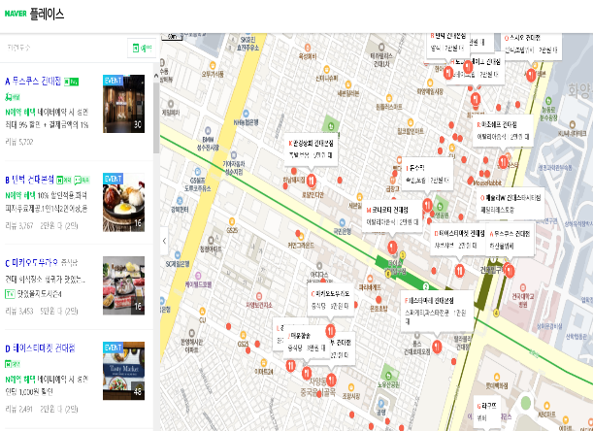
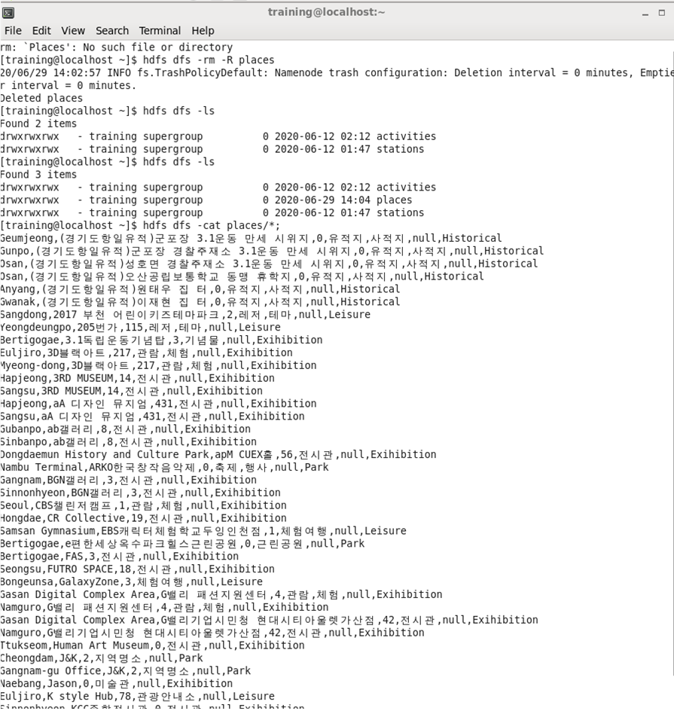
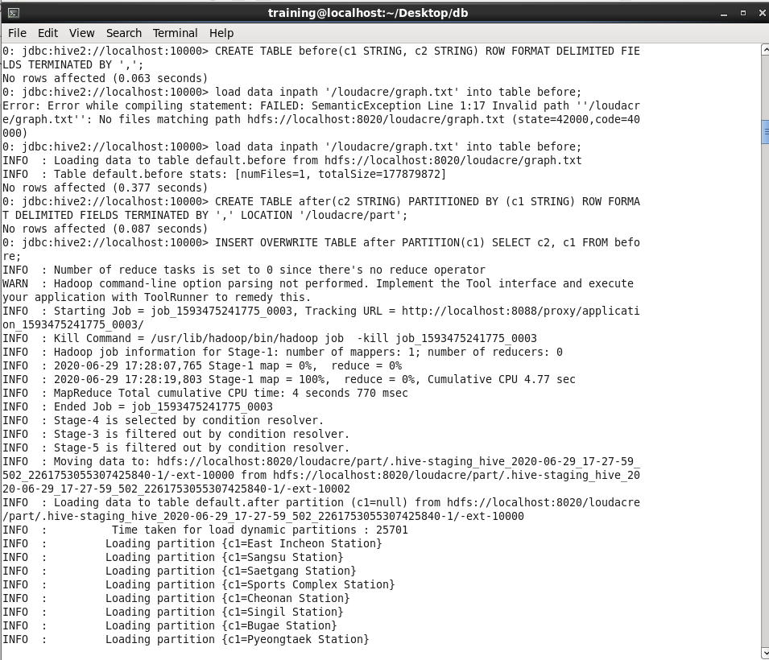
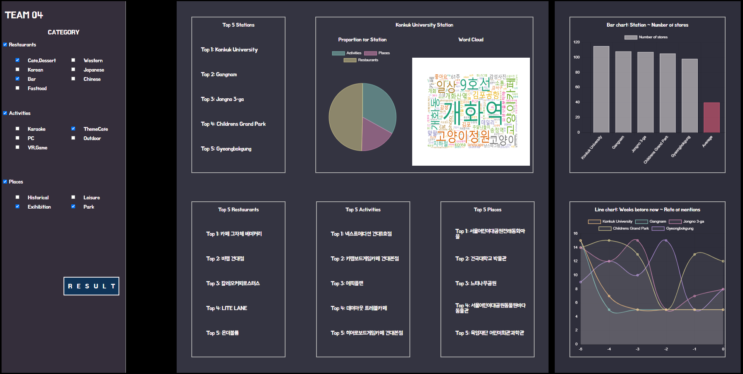
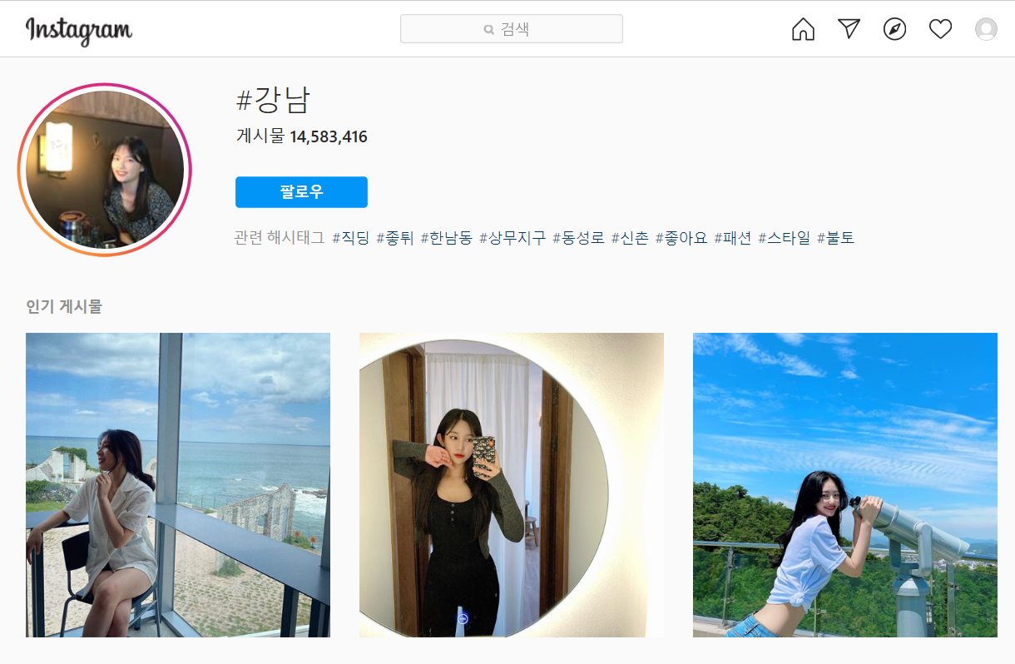
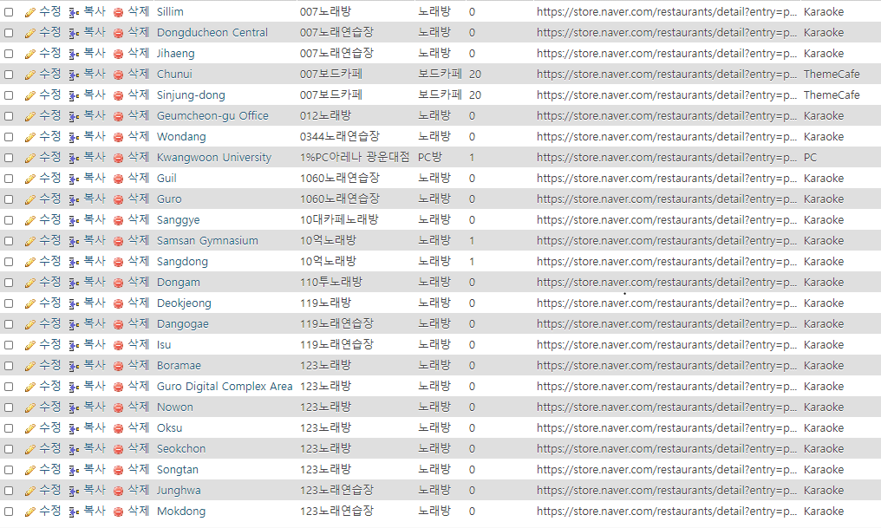
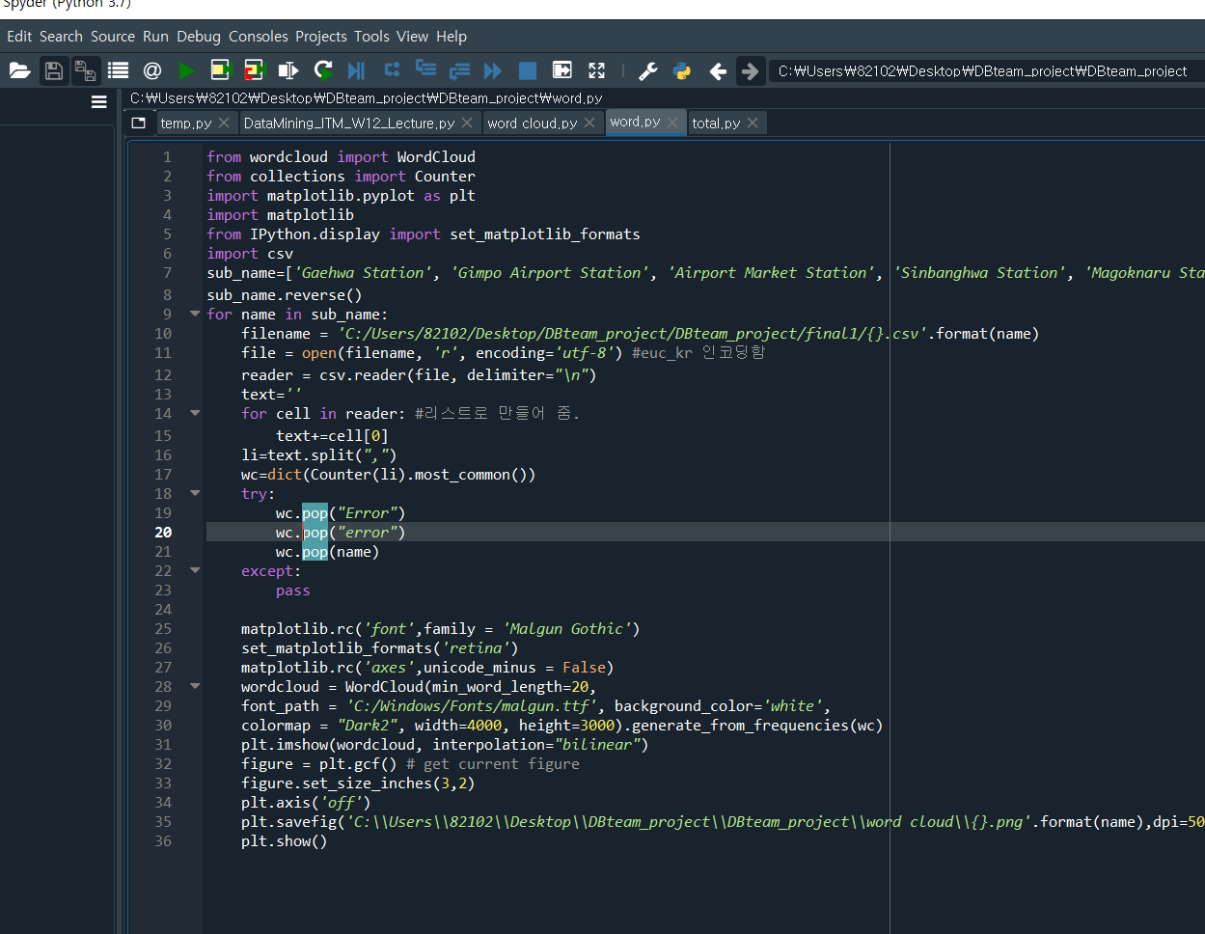
Big Data Processing
1.INGEST 2.PROCESS 3.ANALYZE 4.ACCESS
NAVER
HDFS
HIVE
WEB
INSTAGRAM
MYSQL
PYTHON

Slide 3
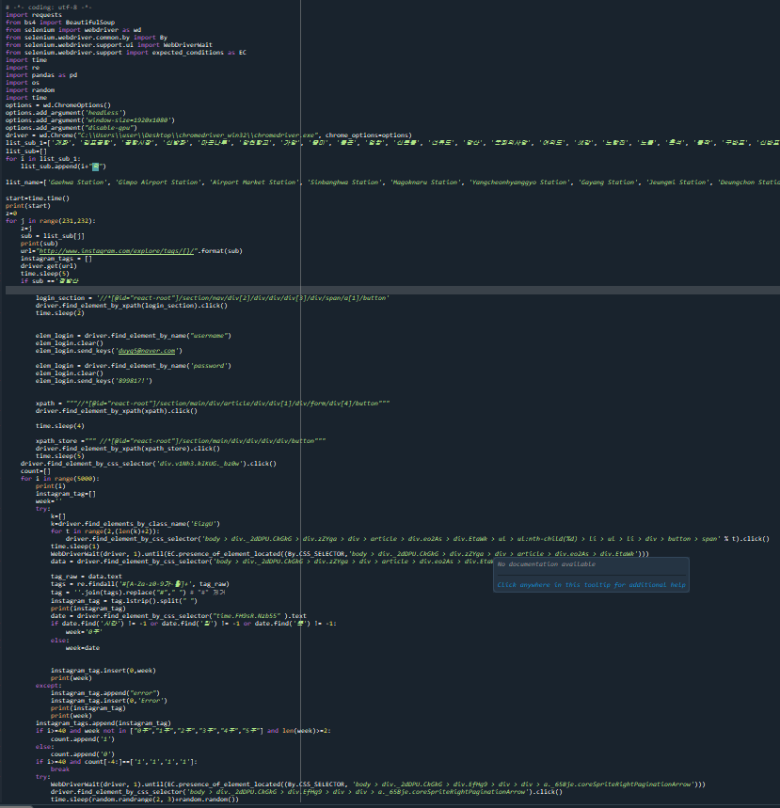
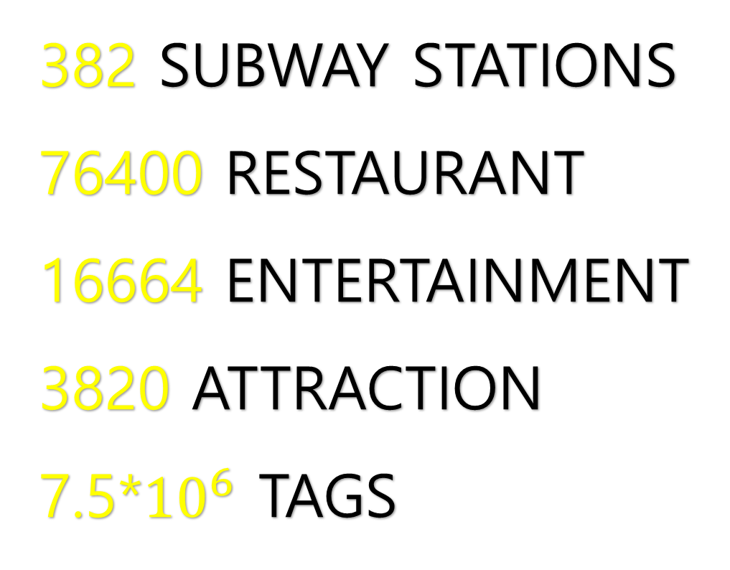
Collecting
382 SUBWAY STATIONS
76400 RESTAURANT
16664 ENTERTAINMENT
3820 ATTRACTION
7.5*${10}^{6}$ TAGS

Slide 4
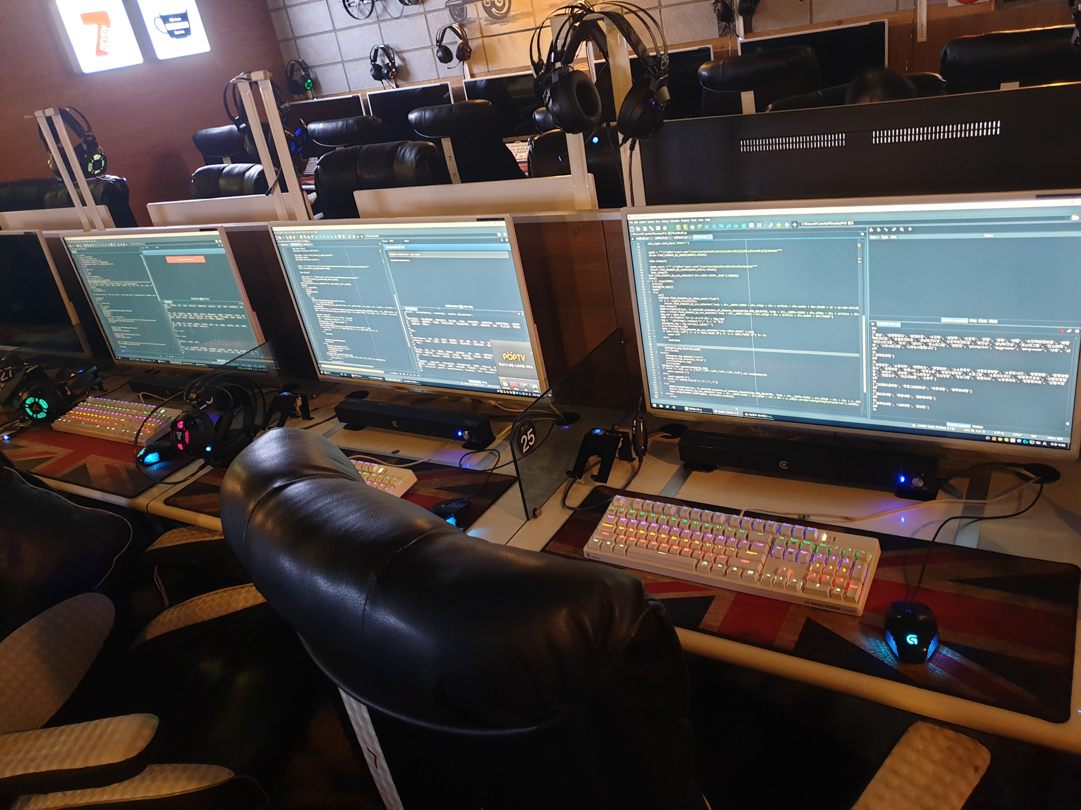
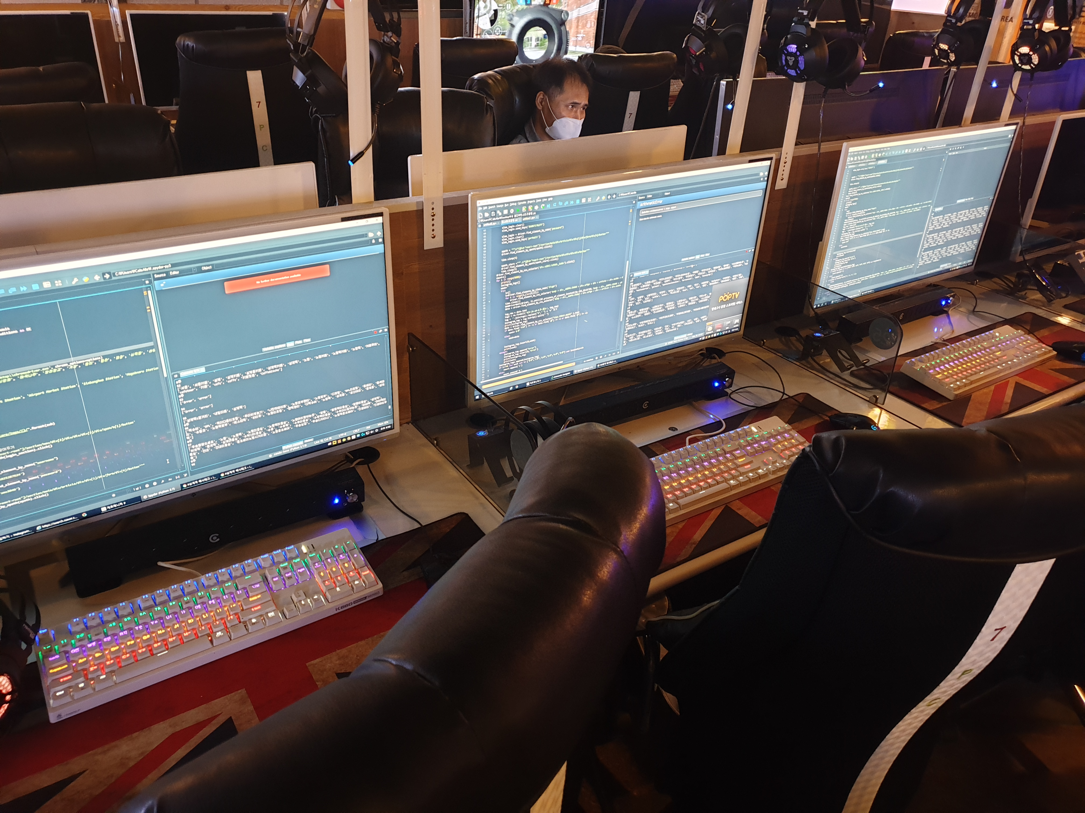
Problem & Debugging
(1)Crawling
In the process of collecting data using crawler, we spend more time than we expected because the crawler’s efficiency is not good and the datas we want are much more than we expected.
We put the more resource to collect data and we try to increase the crawler’s efficiency to reduce the sleep time between approaches to other webpage and analyze the codes’ error.

Slide 5
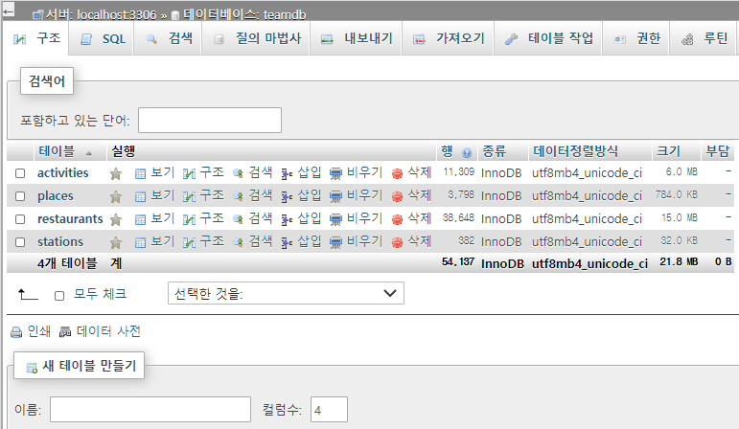
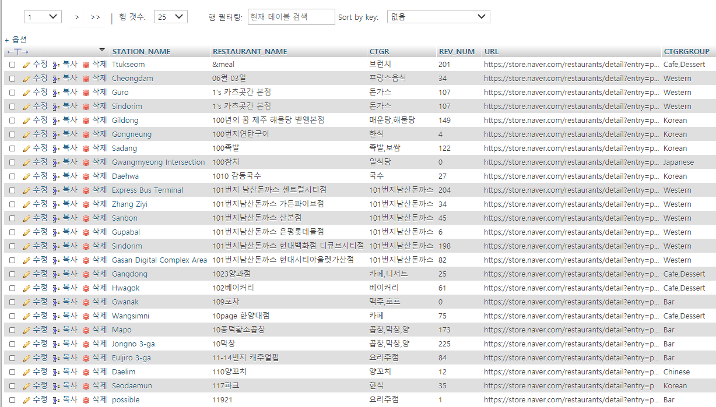
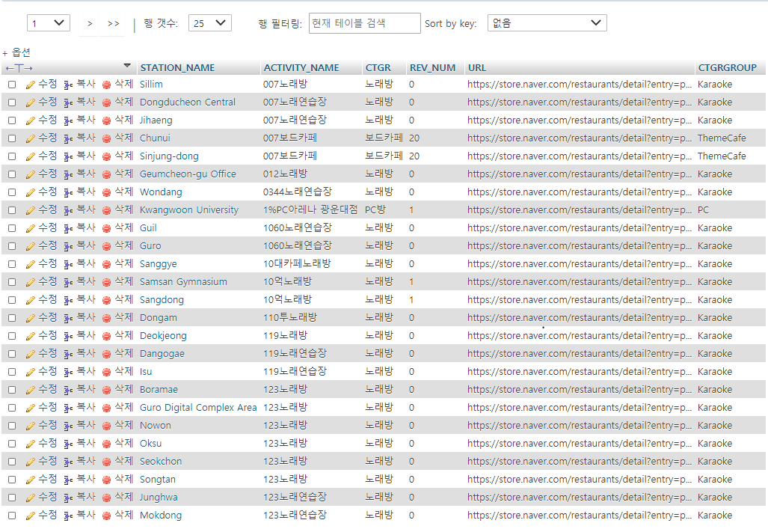
Storage(MySQL)
Upload data to MySQL

Slide 6
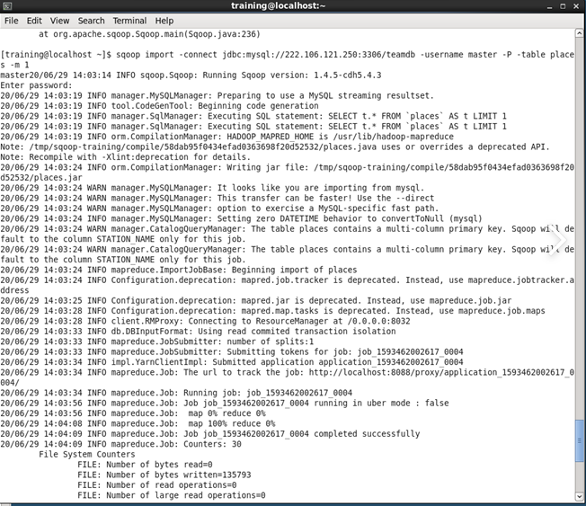
Transferring
Using SQOOP, Move the data into HDFS

Slide 7
Problem & Debugging
(2)HDFS
After we collecting the data, we attempt to HDFS for the store of data.
But we do not find the way of directly load to HDFS.
So we will decide that using MYSQL, we circumvent to the HDFS

Slide 8
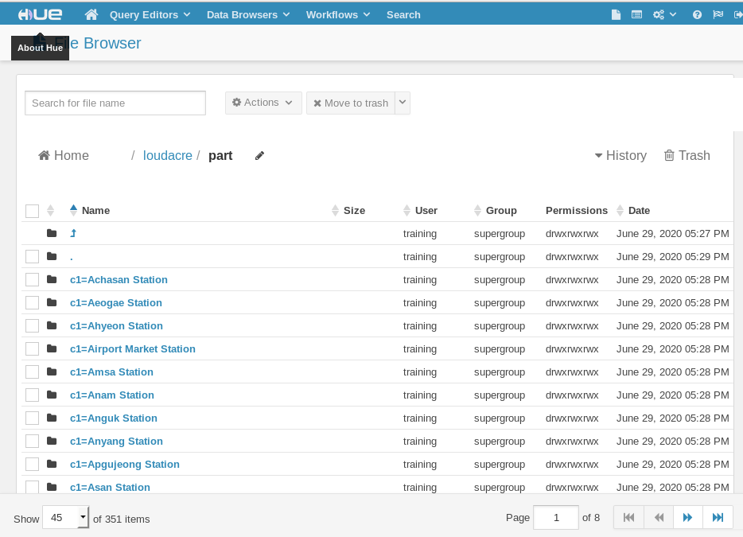
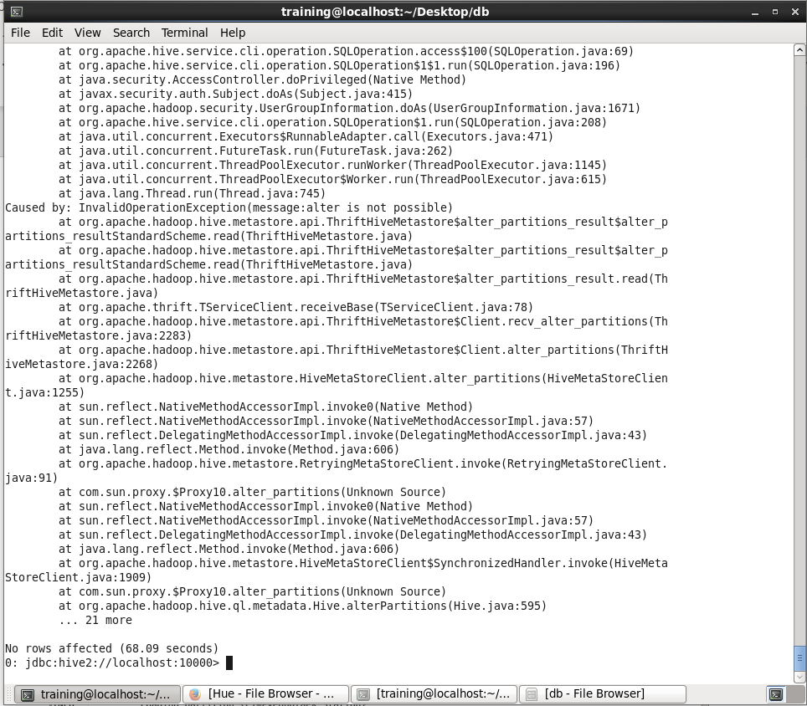
Processing(Hive)
Using Hive, We conduct data preprocessing
and data partitioning

Slide 9
Problem & Debugging
(3)Hive
When we first attempt to conduct partition, there is error message "Error while processing
statement: FAILED: Execution Error, return code 1 from org.apache.hadoop.hive.ql.exe.mr.Map"
So we solve this problem by reducing the unnecessary columns
(In this process, we only need the date column)

Slide 10
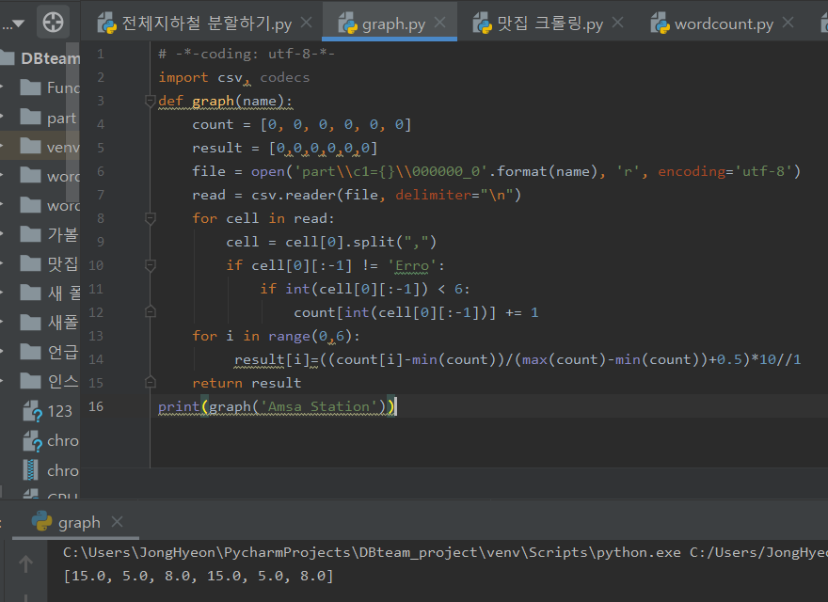
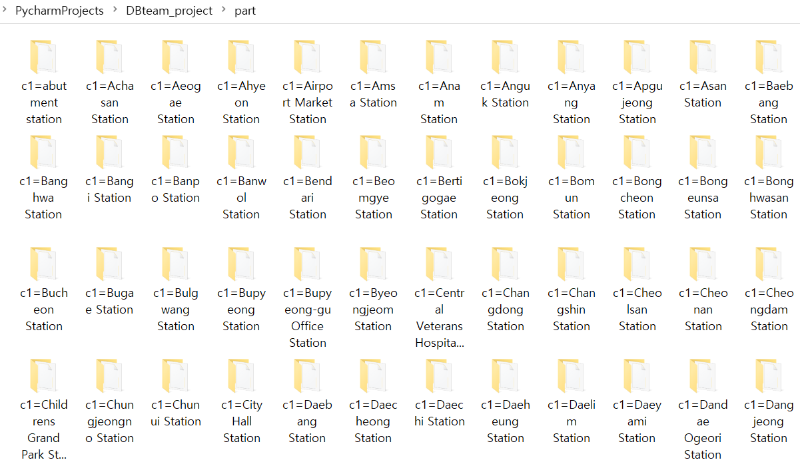
ANALYZE DATA WITH PYTHON
partitioned data ➔ suppose the popularity of station
Problem : failure in accessing(search) file

Slide 11
ANALYZE DATA WITH PYTHON
Partitioned data ➔ suppose the popularity of station

Slide 12
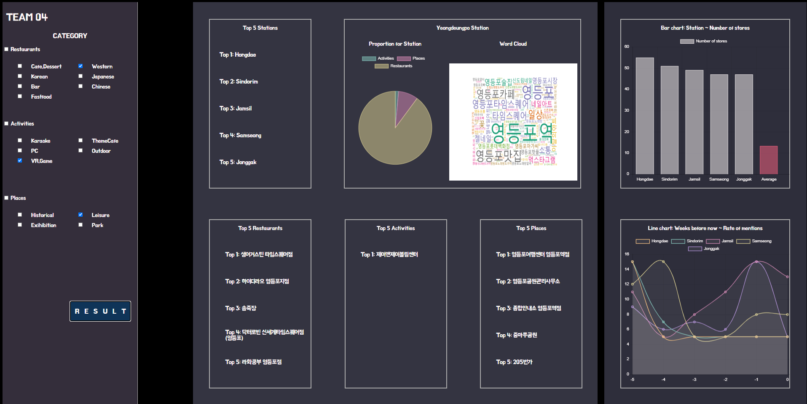
Webpage

Slide 13
Webpage-Structure
Overall Structure:
-> Raw Data
-> Data processing with / without HDFS
-> Store data into Database Server
-> Building Connection between Database server and Web server with php / sql
-> Organize Web with PHP / Java Script / HTML
-> Implementing functions with PHP / Java Script / Python
-> Available Web page for people
Flow Chart
Raw Data
HDFS
Data Processing
Database Server
Construct Connection
Webpage Server
Visualizing Service
Webpage

Slide 14
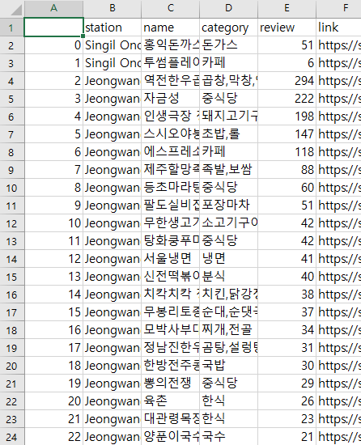
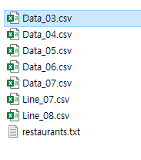
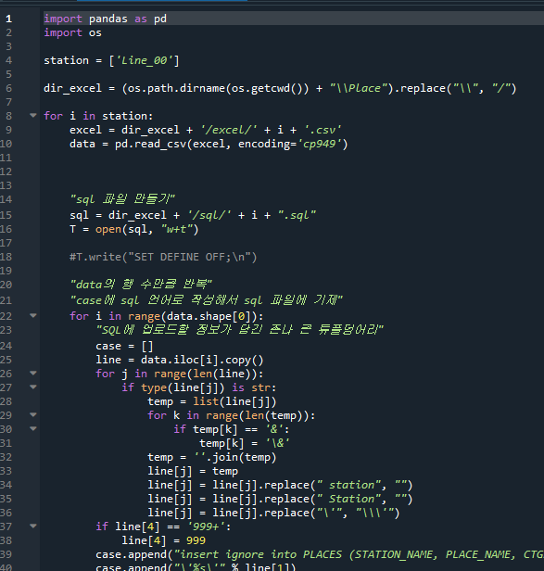
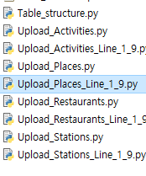
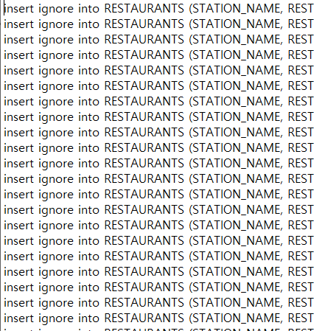
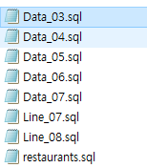
Webpage-Structure
Raw Data:
- Stores by category:
- by Crawling by Python
- for measuring scale of infrastructure
- info:
- Name of station; Name of store; Type of store;
- Category of store; Number of reviews; Link;
Number of mentions
- by Crawling by Python
- for measuring degree of activation
- info:
- tag of instargram posts, uploaded time
Data Processing:
- Trim raw data for database:
- by using Python
- csv -> sql
- for each tables
- Stations; Activities; Places; Restaurants;
Database Server:
- MySQL:
- as form of table
- by big categories
- Stations; Activities; Places; Restaurants;
- Hadoop:
- as form of table
- by subway station(partitioned by station)
- Stations; weeks; tags

Slide 15
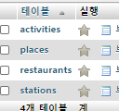
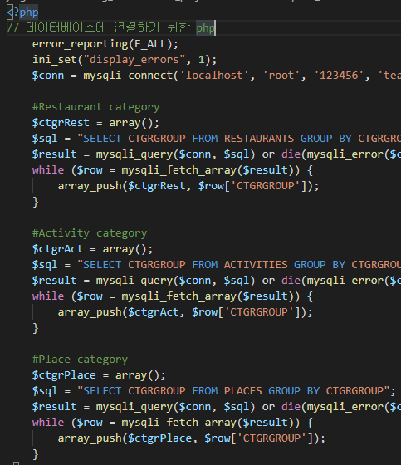
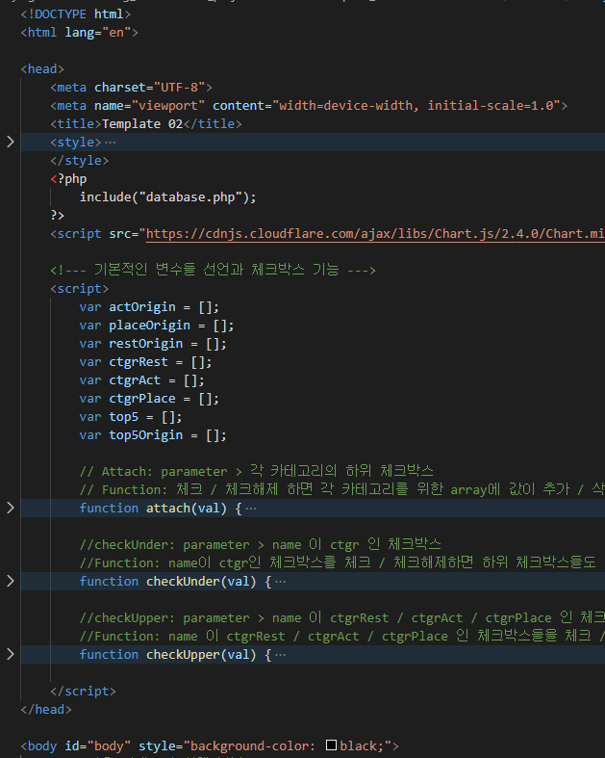
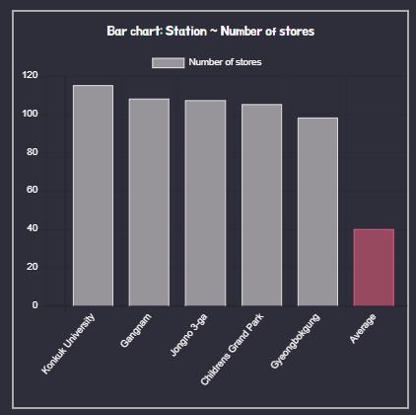
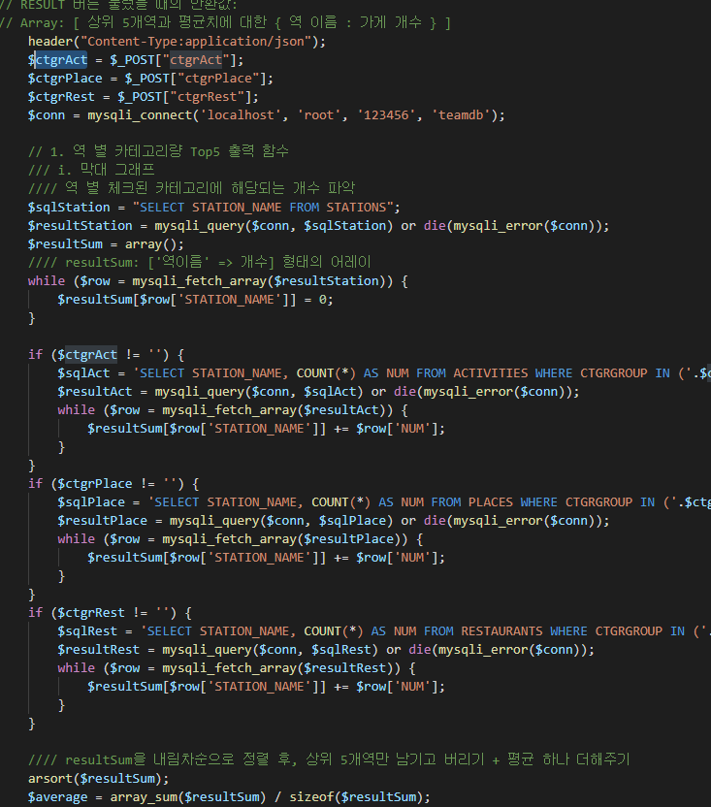
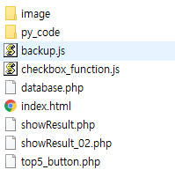
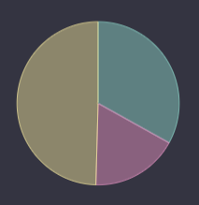
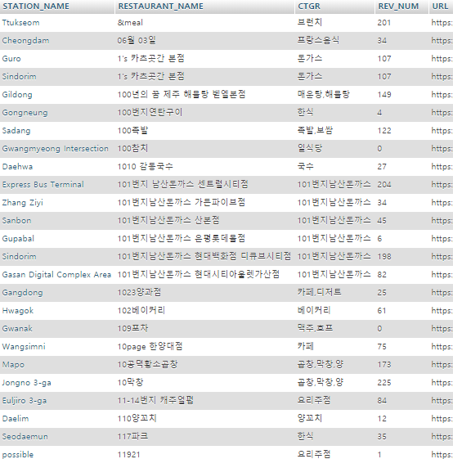
Webpage-Structure
Construct Connection:
- Building connection for transmission:
- by using PHP and SQL
Visualizing Service:
- by Java Script / PHP / Python:
- Organizing codes / import packages(chart.js)
Webpage Server:
- Apache:
- based on HTML with many languages
- Enable external connection

Slide 16


Webpage-Structure
Directory: py_code
Files & Directories Structure:
Storage for data about Python
Directory: part
Storage for raw data through HDFS
users
database.php
Index.html
graph.py
Database: MySQL
Essential data for UI
UI / Interaction
Function for data processing
showResult.php
Top5_button.php
Functions / Changes for user’s behaviors
Directory: image
Functions / Changes for user’s behaviors
Storage for processed image through HDFS
showResult_02.php
Created input(<button>, etc)
Functions / Changes for user’s behaviors
UI / Interaction

Slide 17
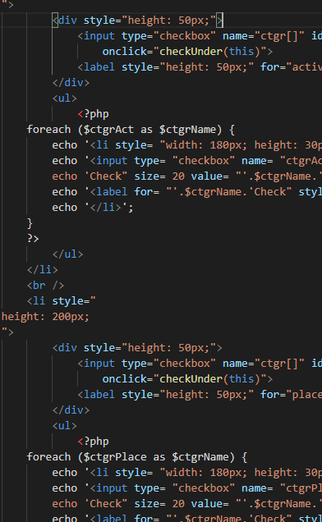
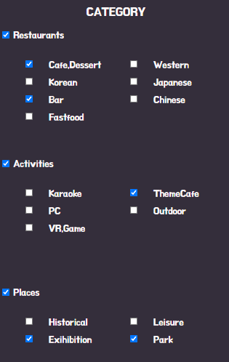
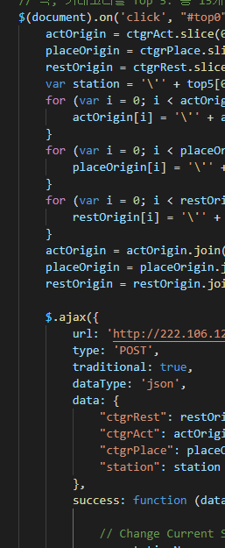
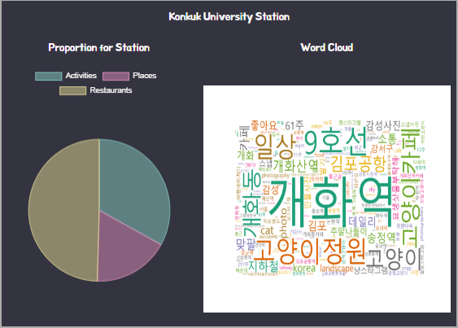
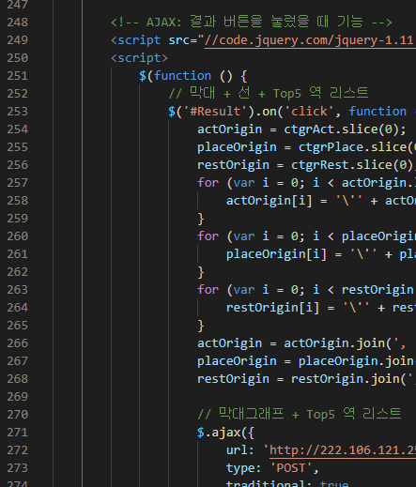
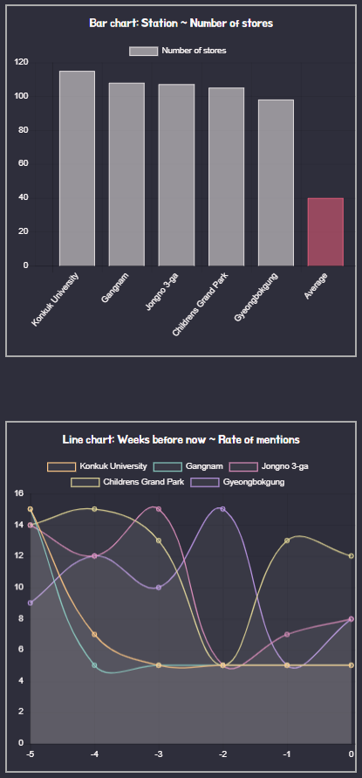
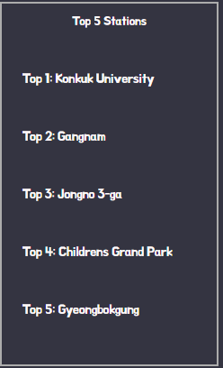
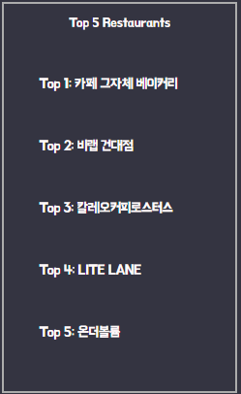
Webpage-Implementation
Category checkboxes
- Enable users to choose their interests
- Get ‘category’ data from database
- Functions for checkbox-to-checkbox association
- Used Languages: PHP / HTML / Java Script
Button for result
- Show result about user’s choice
- Get data from database / directory
- Draw Bar chart / Line chart
- Bar chart for {station, number of stores}
- Line chart for {weeks, rate of mention}
- List top 5 stations
- as button
- Functions for buttons
- Used Languages: PHP / HTML / Java Script
Top 5 Stations as Button
- Show result about user’s choice
- Get data from database / directory
- Draw Pie chart / load Word cloud
- Pie chart for {category, number of stores}
- Line chart for {weeks, rate of mention}
- List top 5 stores for each categories
- as image / chart / list
- Used Languages: PHP / HTML / Java Script / Python

Slide 18
Problem & Debugging
(4)Webpage
Error without any return
-99% php error
-Unable to specify the fault point
Error 400, 404, 500, etc
-Some scripts became wrong
Error from html / Java Script / sql / Python
-Possibility of syntax error or extra
Click the line that occur error
Check for grammatical error
Using <script>alert();</script>
Follow logical procedure
Using <script> console.log(); </script>
Break suspicious points and check if it printed
Follow the logical procedure
Using <script> console.log(); </script>
Break suspicious points and check if it printed
Follow the logical procedure

Slide 19
Thank you

